Slide 1
E-Learning Platform
Student: Marsel Yuldashev
Supervisor: AL-Magsoosi Husam Kareem Farhan

Slide 2
Agenda
Short overview
Use-cases walkthrough
Technologies walkthrough
Size

Slide 3

Index page

Slide 4
Agenda
Short overview
Use-cases walkthrough
Technologies walkthrough
Size

Slide 5
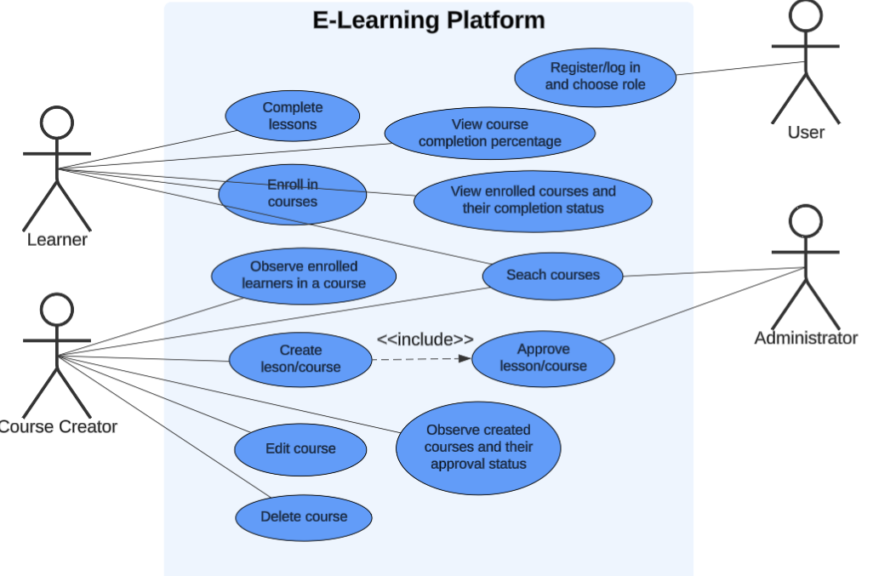
UML diagram

Slide 6
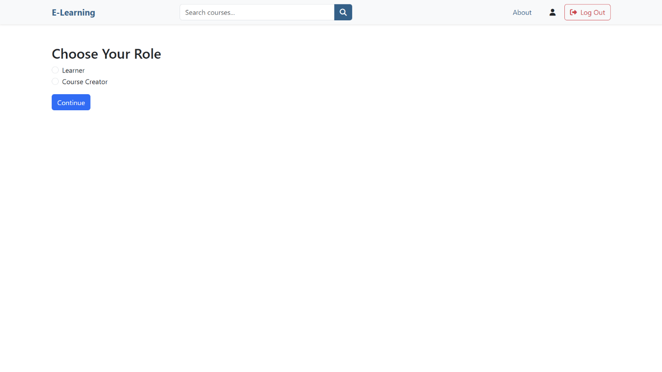
User: Register/log in and choose role

Slide 7

Course Creator: Create lesson/course

Slide 8
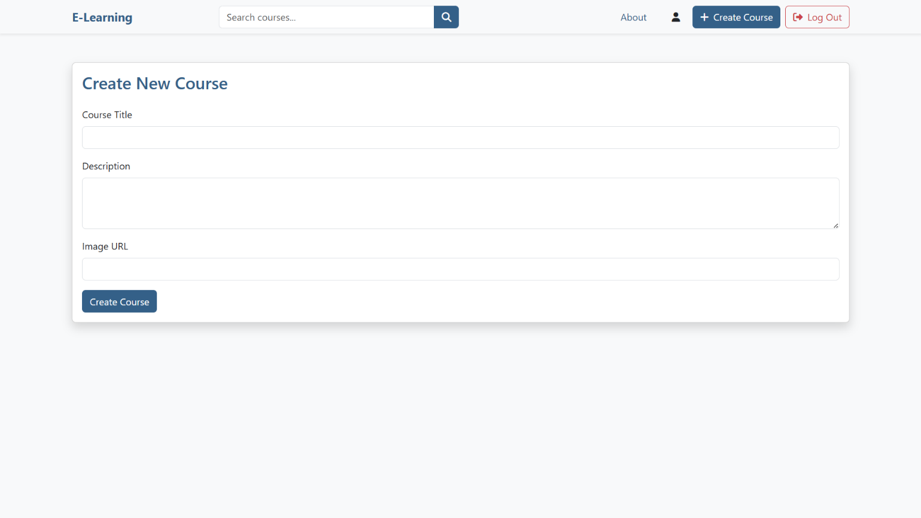
Course Creator: Create lesson/course

Slide 9
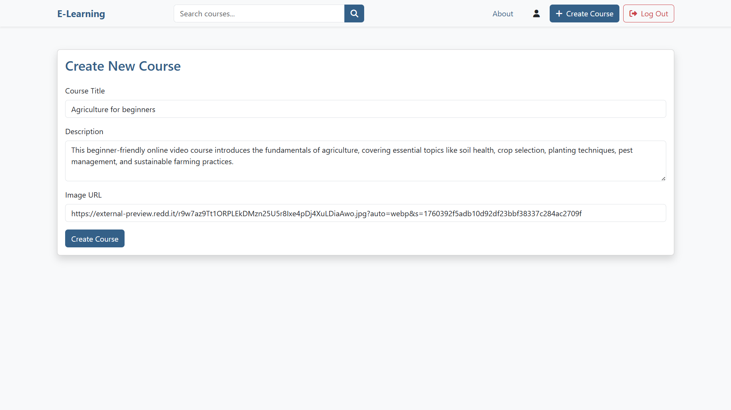
Course Creator: Create lesson/course

Slide 10
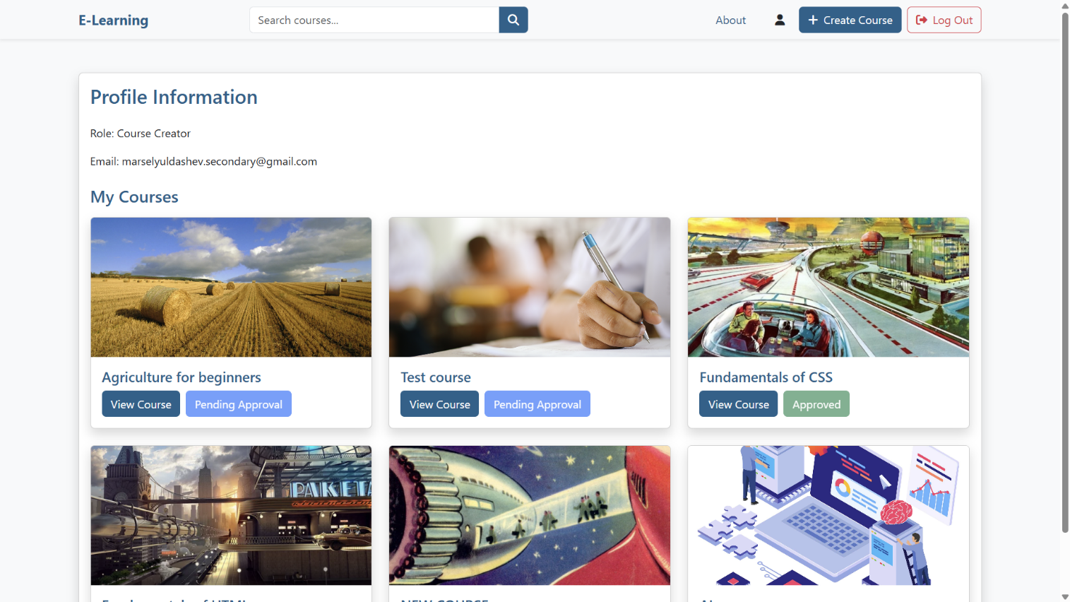
Course Creator: Create lesson/course

Slide 11
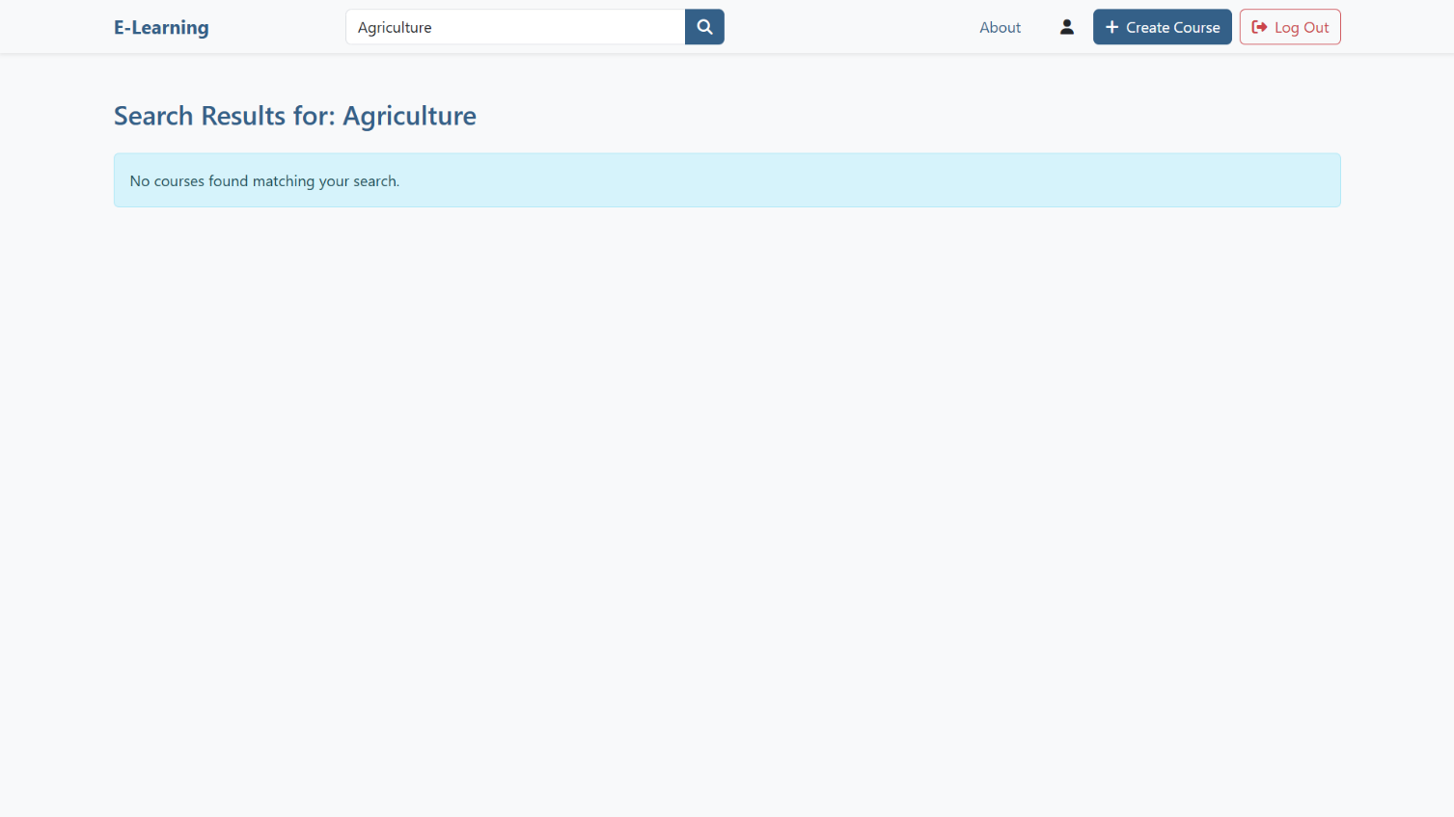
Course Creator: Create lesson/course

Slide 12
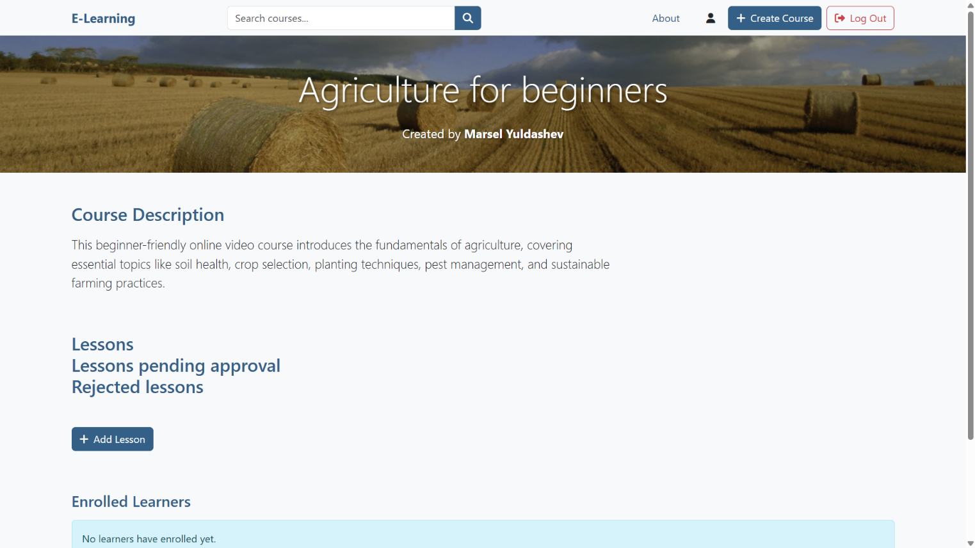
Course Creator: Create lesson/course

Slide 13
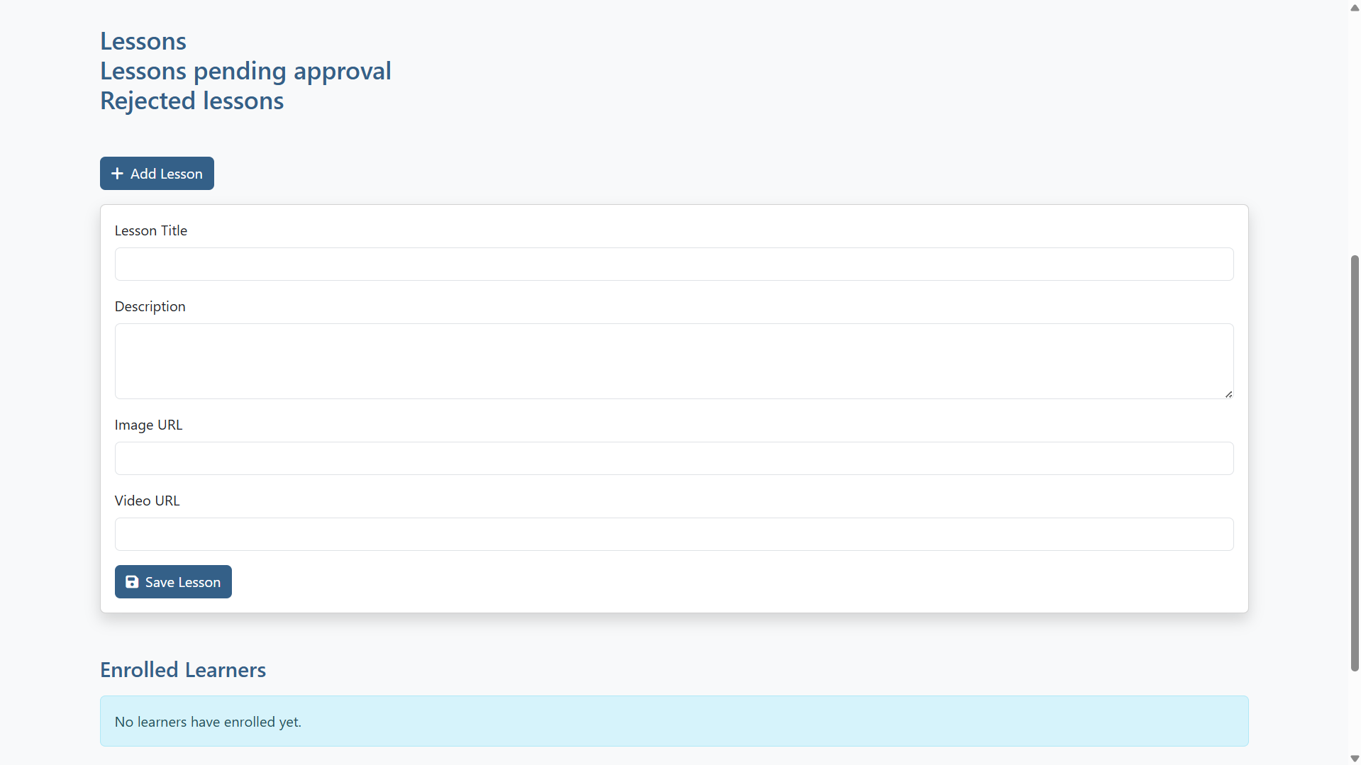
Course Creator: Create lesson/course

Slide 14
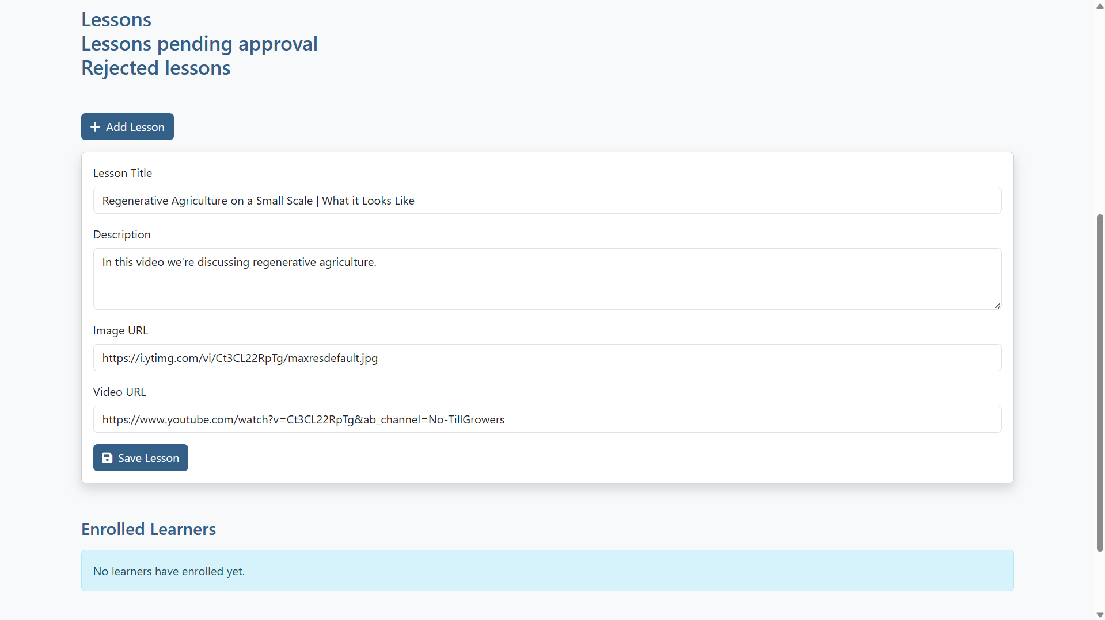
Course Creator: Create lesson/course

Slide 15
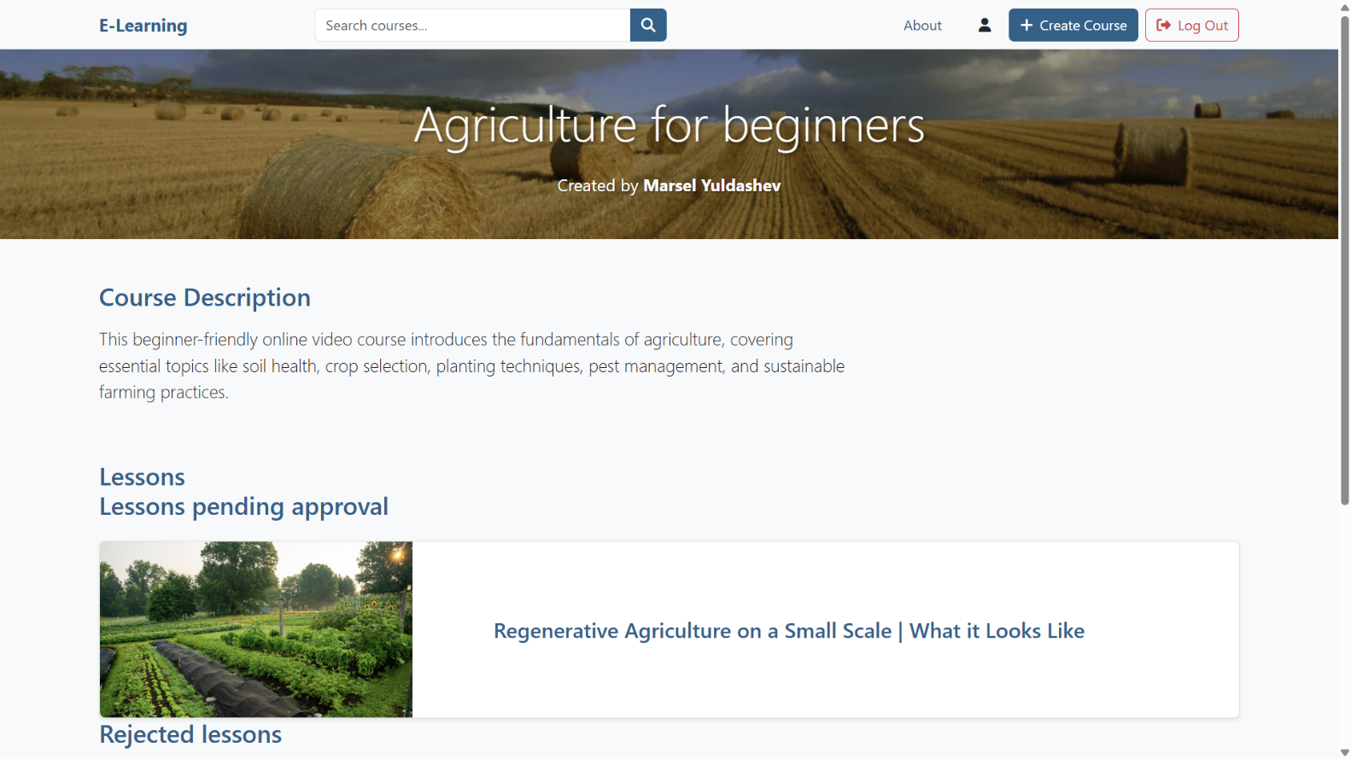
Course Creator: Create lesson/course

Slide 16
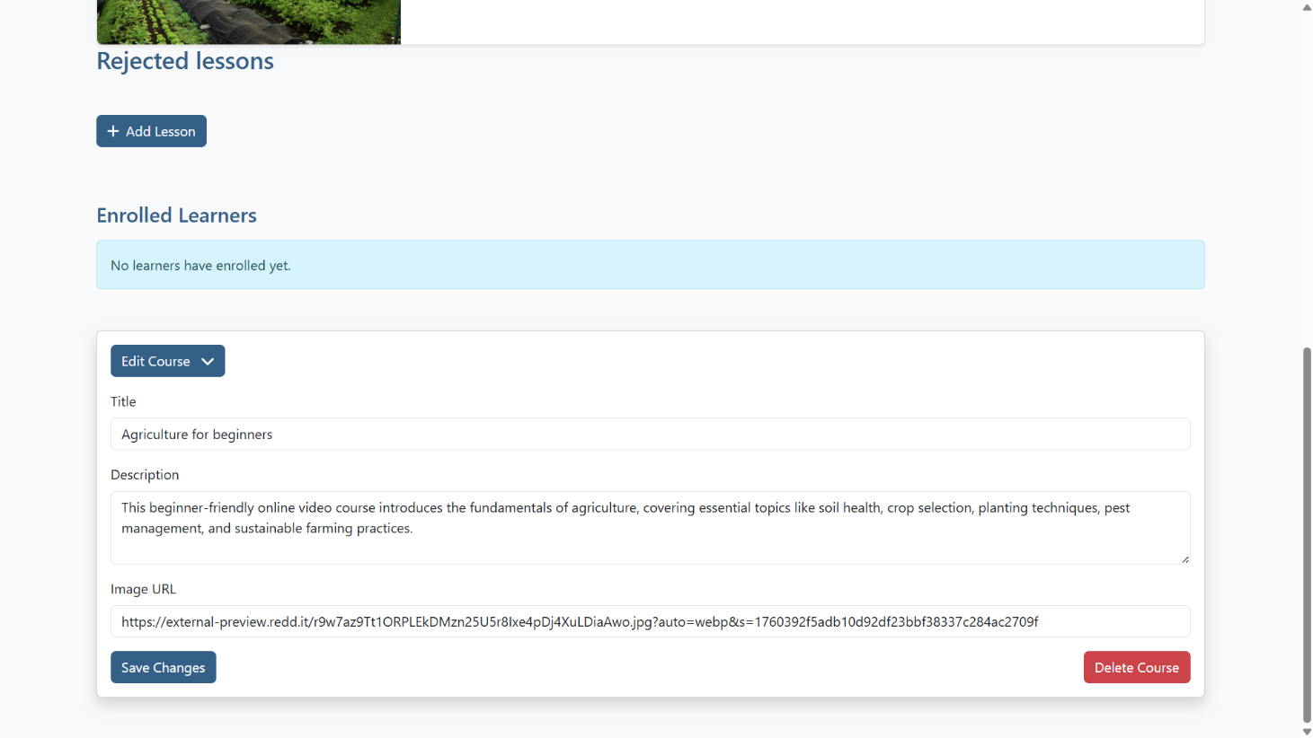
Course Creator: Edit/delete course

Slide 17
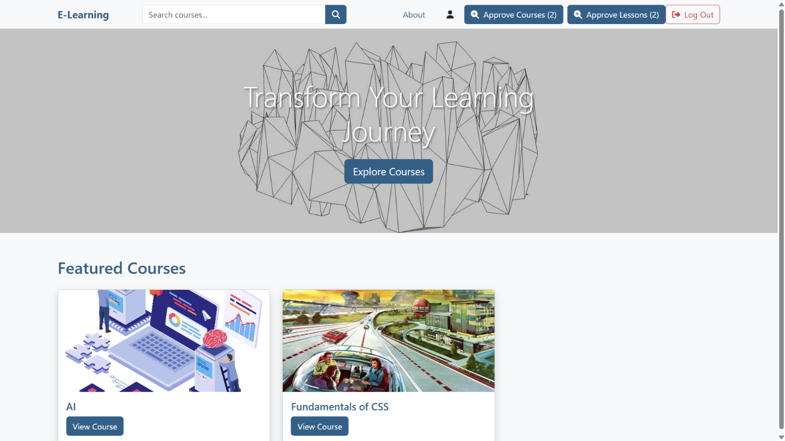
Administrator: Approve lesson/course

Slide 18
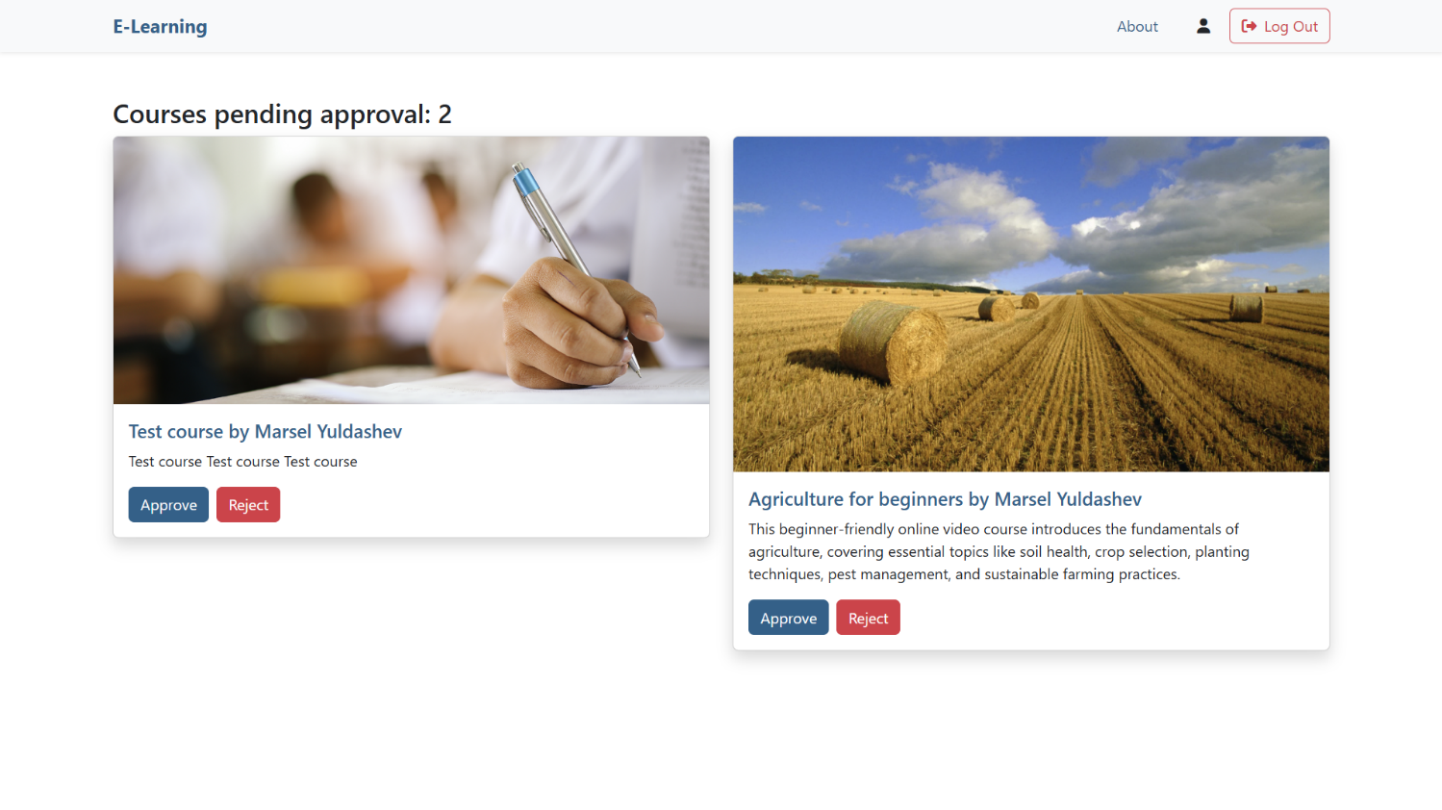
Administrator: Approve lesson/course

Slide 19
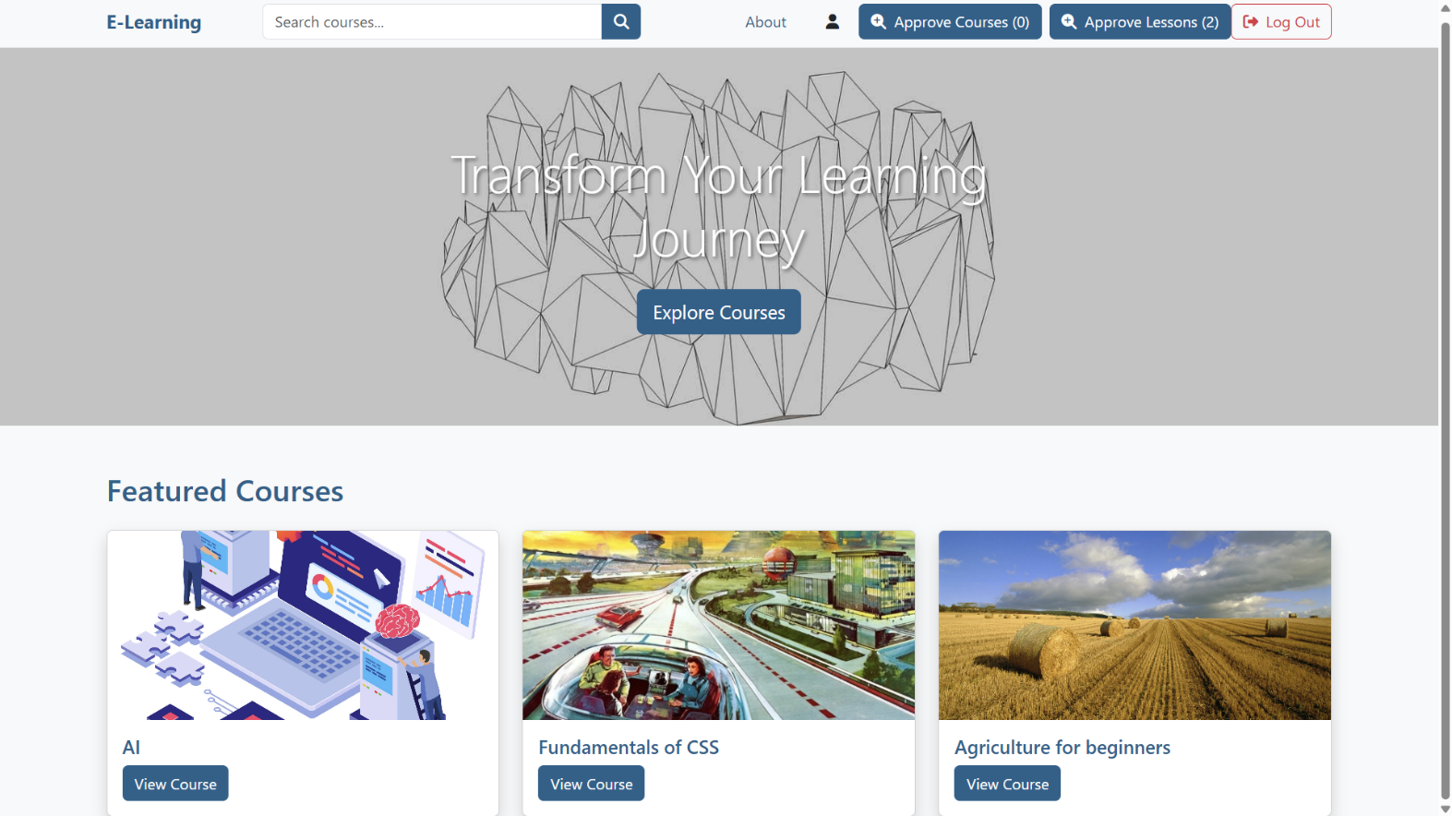
Administrator: Approve lesson/course

Slide 20
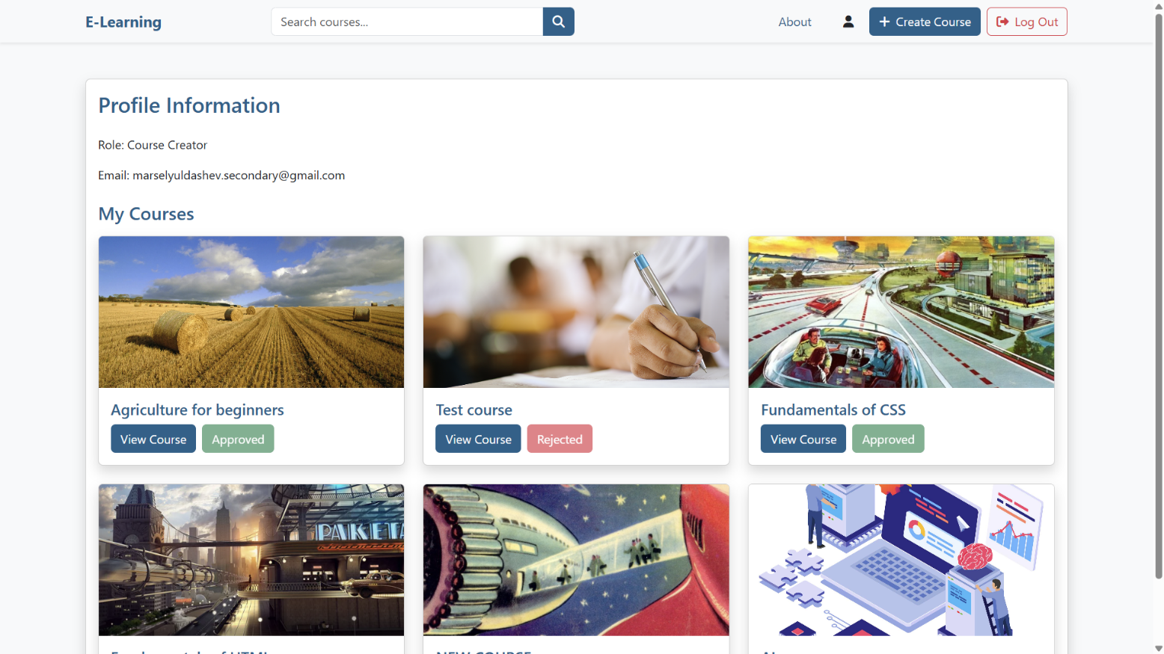
Administrator: Approve lesson/course

Slide 21
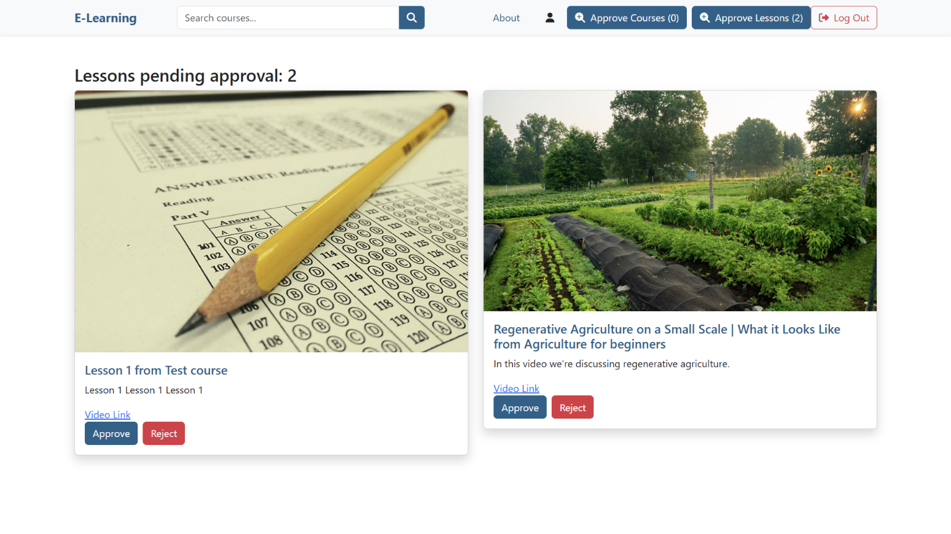
Administrator: Approve lesson/course

Slide 22
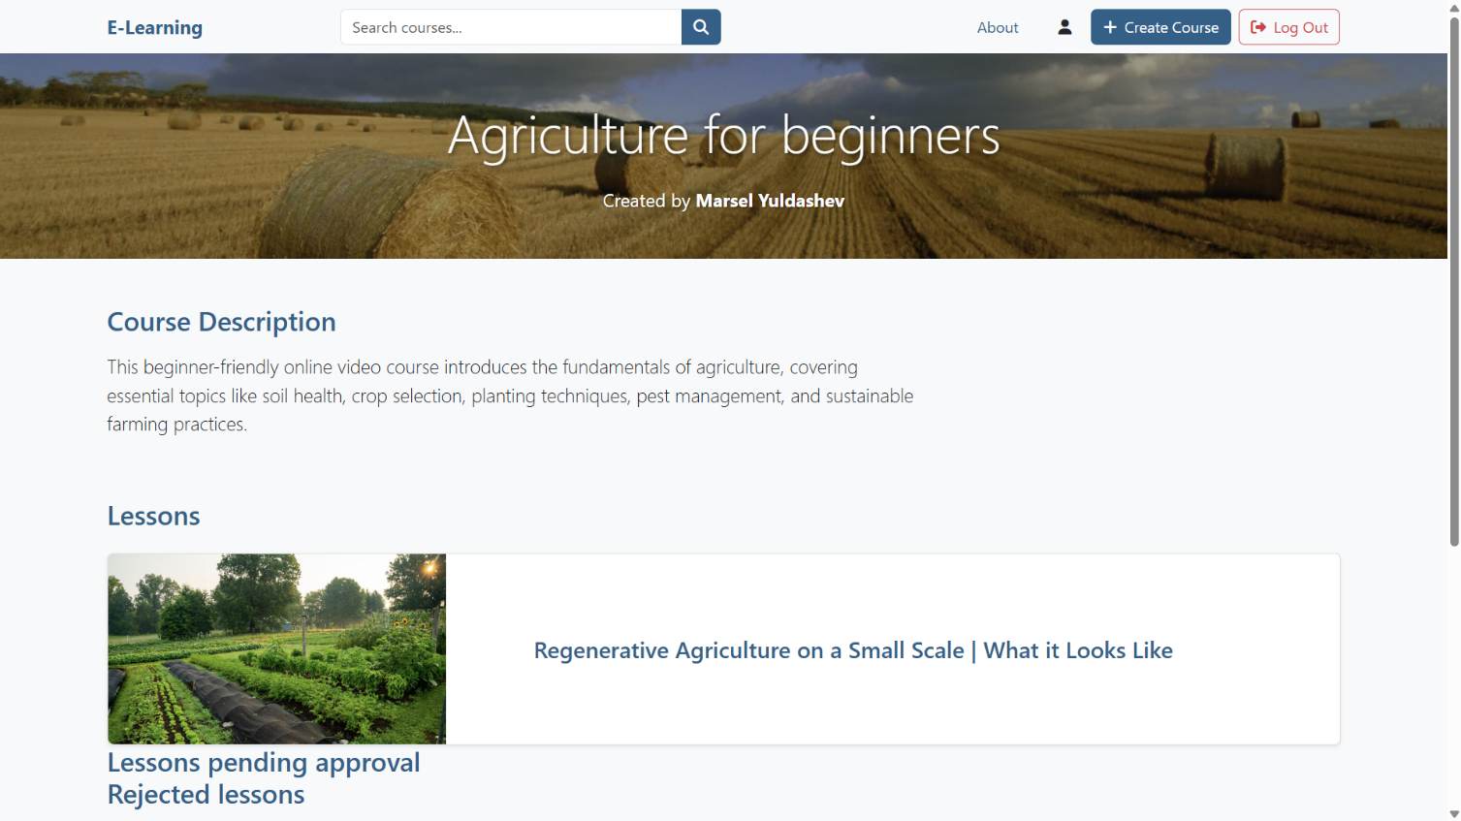
Administrator: Approve lesson/course

Slide 23
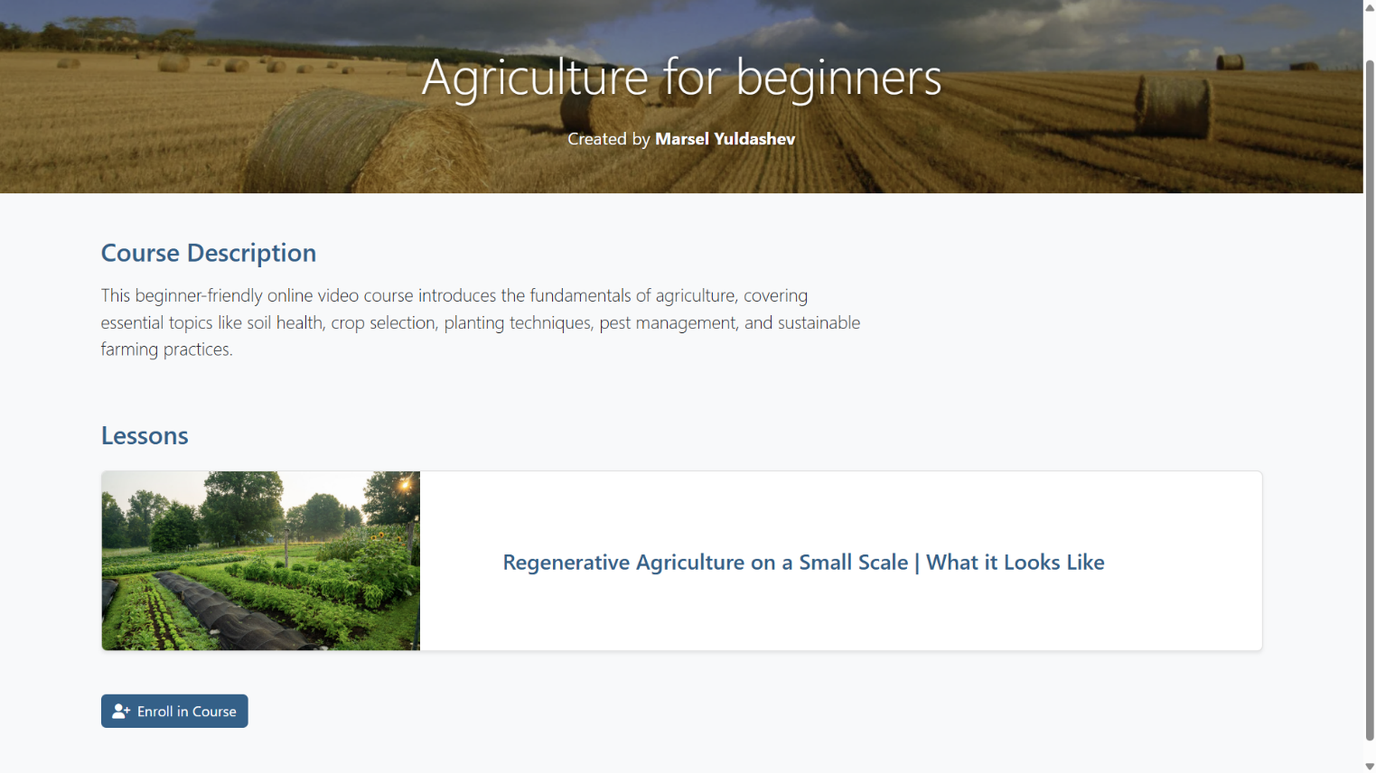
Learner: Enroll in courses

Slide 24
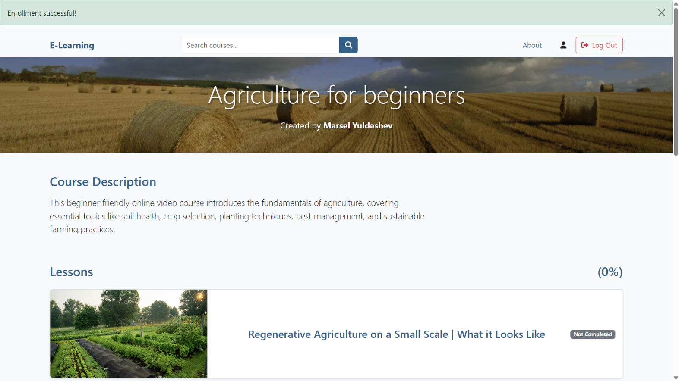
Learner: Enroll in courses

Slide 25
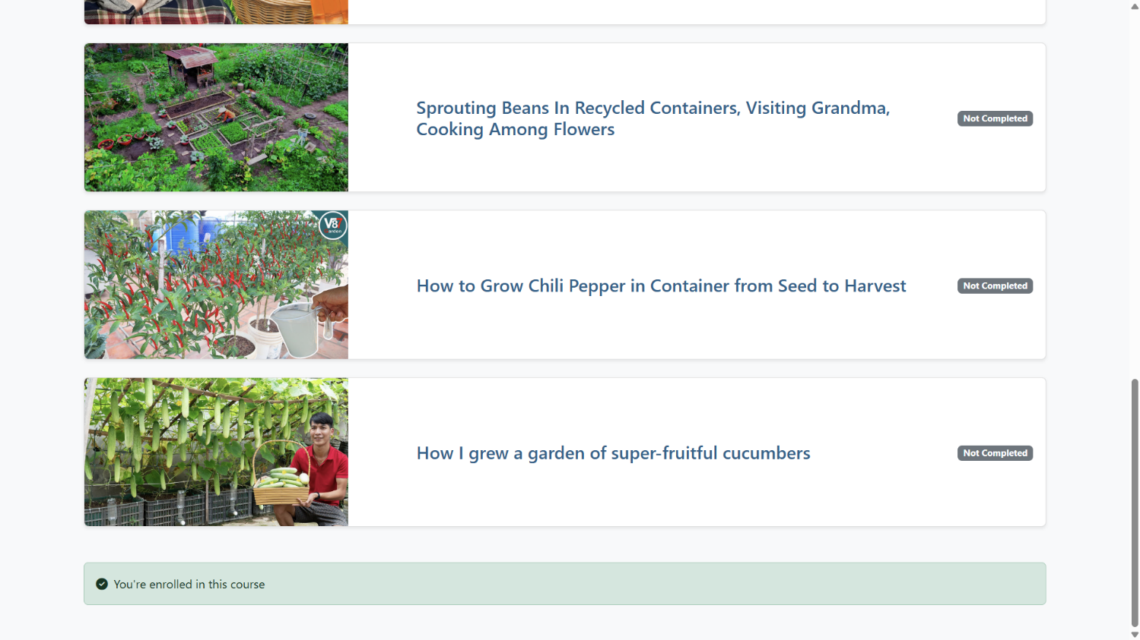
Learner: Enroll in courses

Slide 26
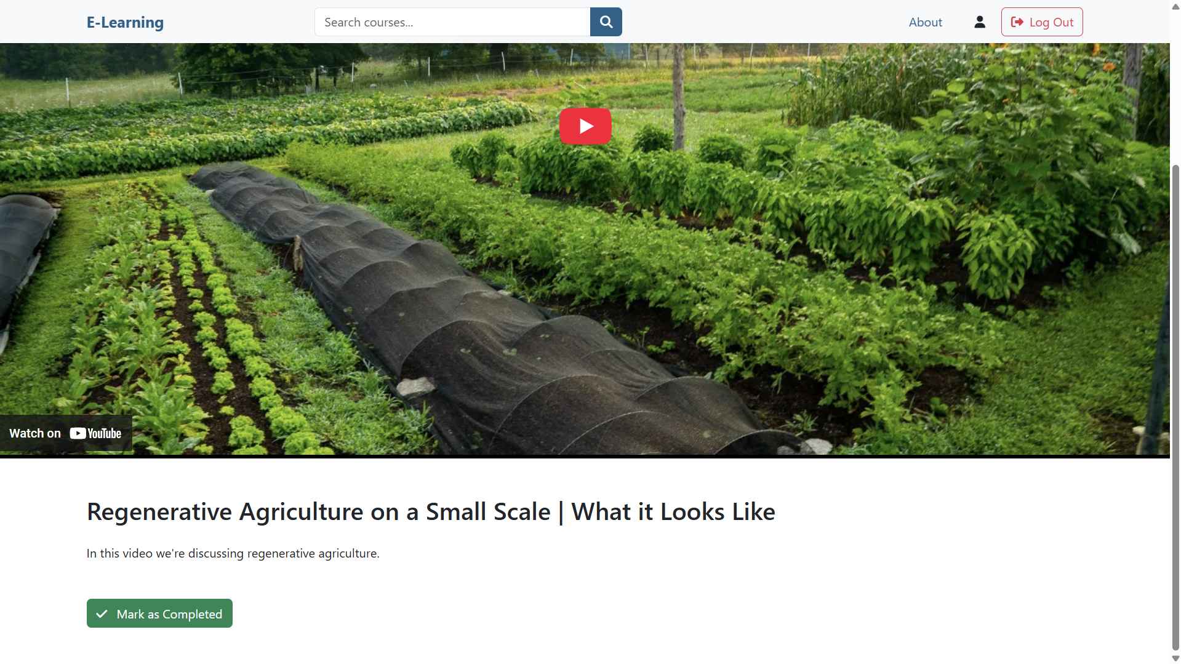
Learner: Complete lessons

Slide 27
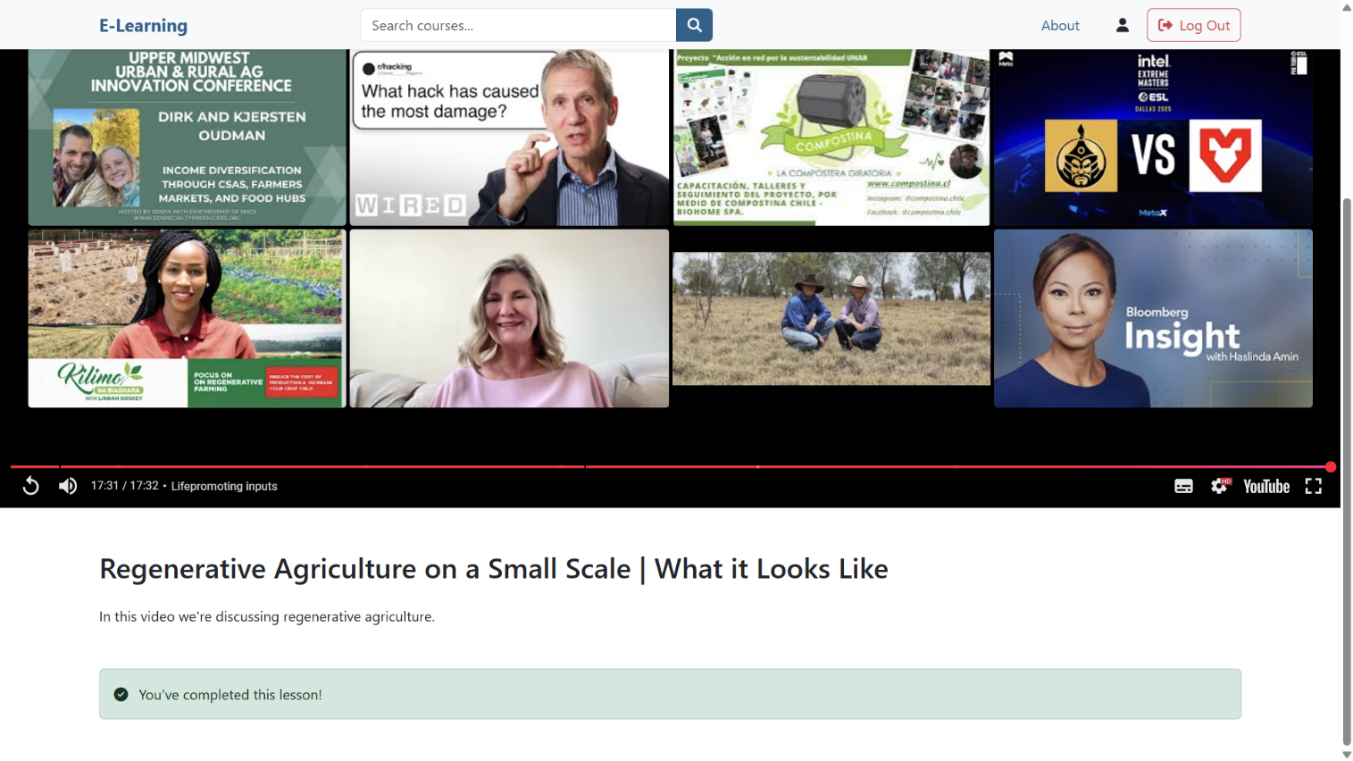
Learner: Complete lessons

Slide 28
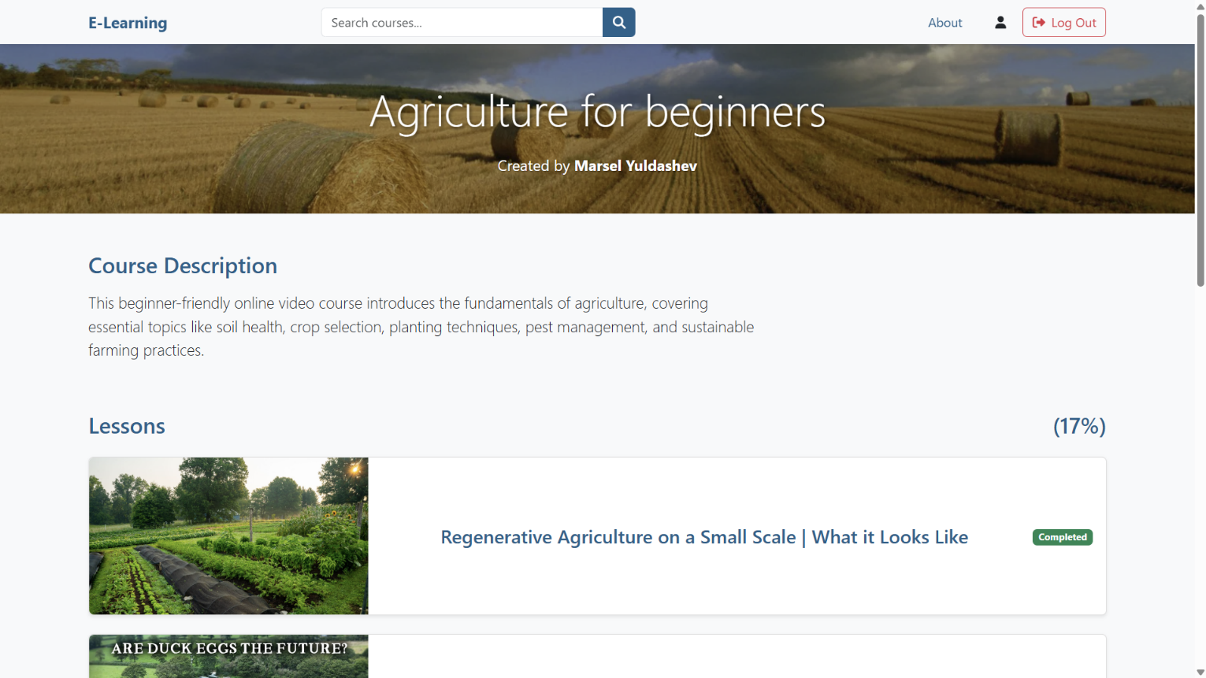
Learner: View course completion percentage

Slide 29
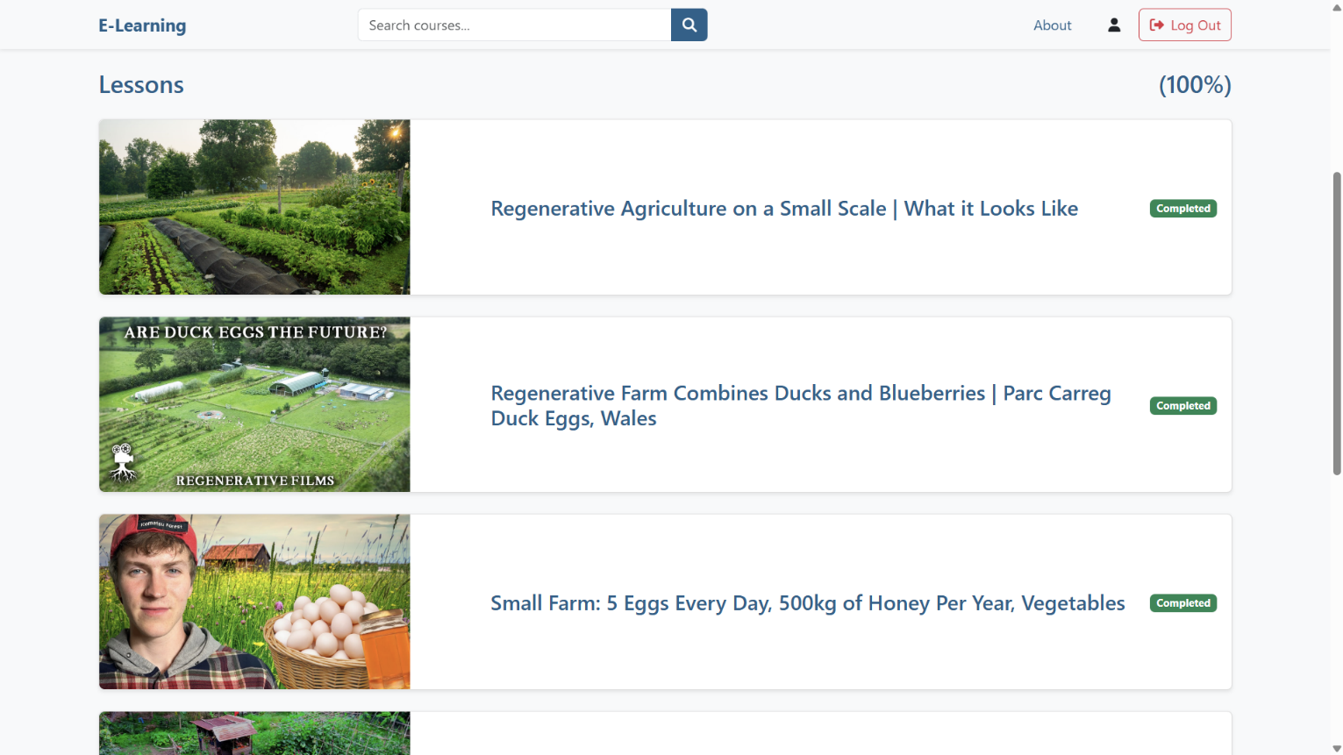
Learner: View course completion percentage

Slide 30
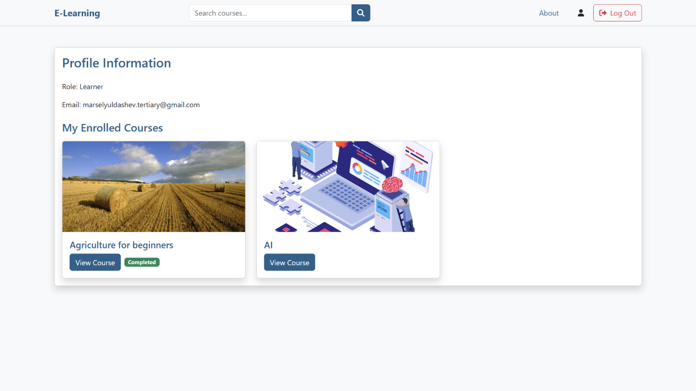
Learner: View enrolled courses and their completion status

Slide 31
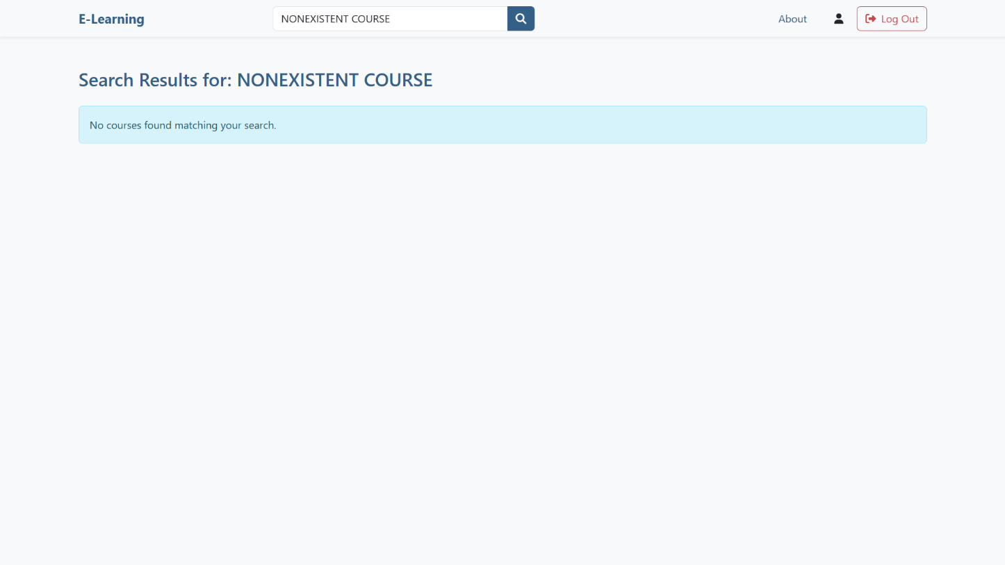
Learner, Administrator, Course Creator: Search courses

Slide 32
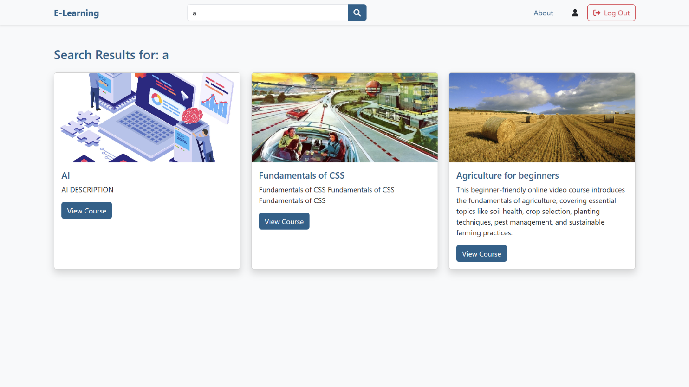
Learner, Administrator, Course Creator: Search courses

Slide 33
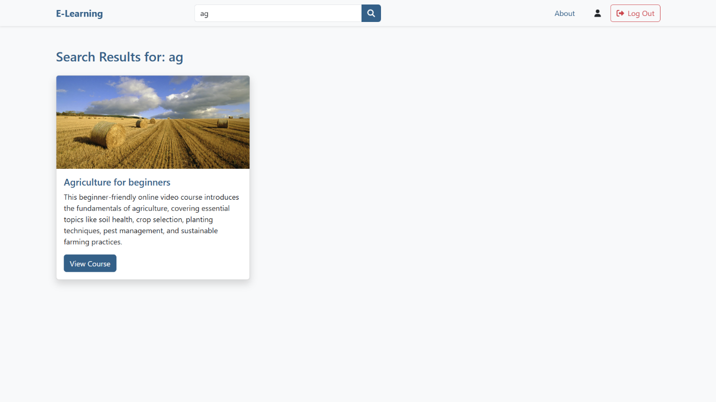
Learner, Administrator, Course Creator: Search courses

Slide 34
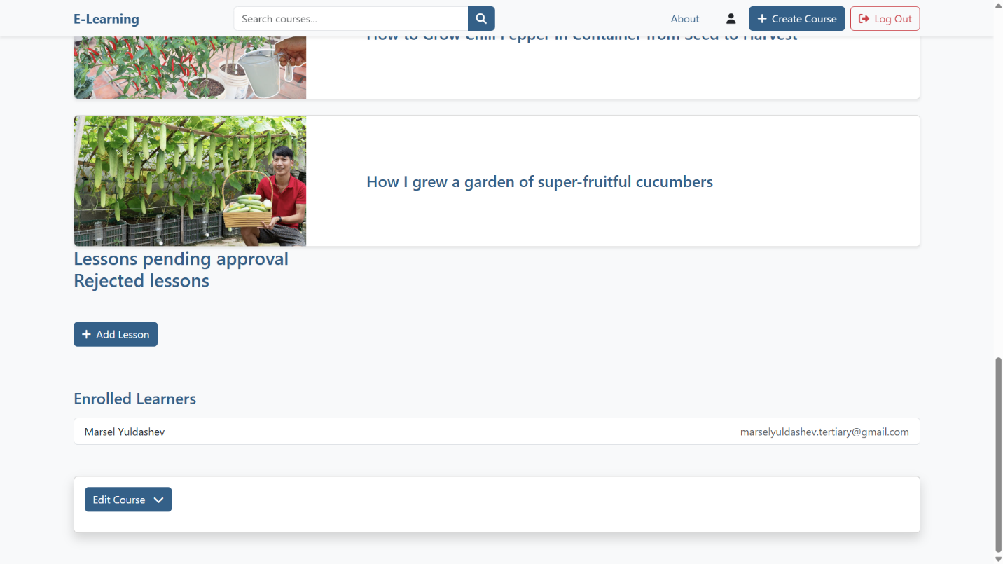
Course Creator: Observe enrolled learners in a course

Slide 35


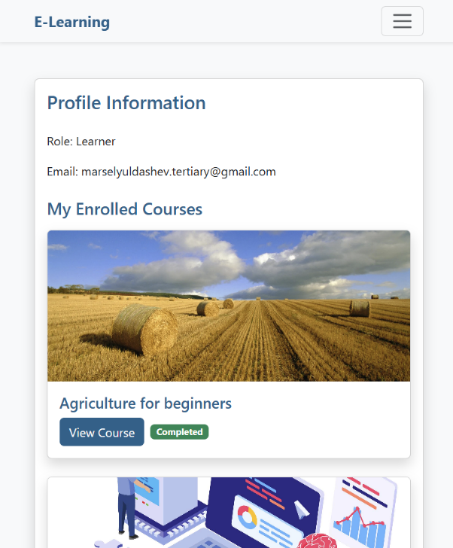
Responsiveness

Slide 36
Agenda
Short overview
Use-cases walkthrough
Technologies walkthrough
Size

Slide 37
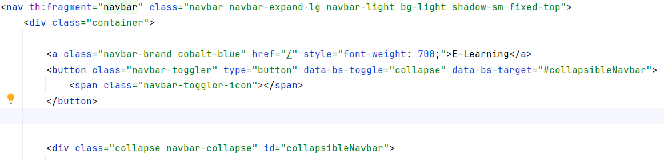
Bootstrap

Slide 38
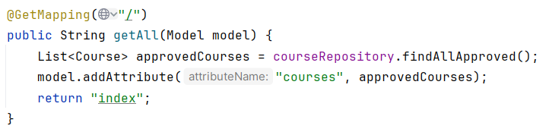
Thymeleaf

Slide 39
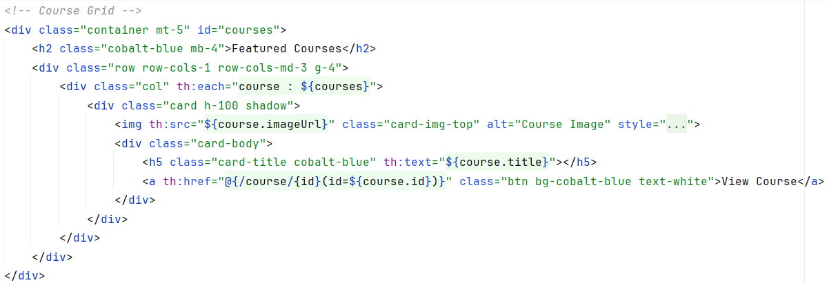
Thymeleaf

Slide 40
Font Awesome

Slide 41
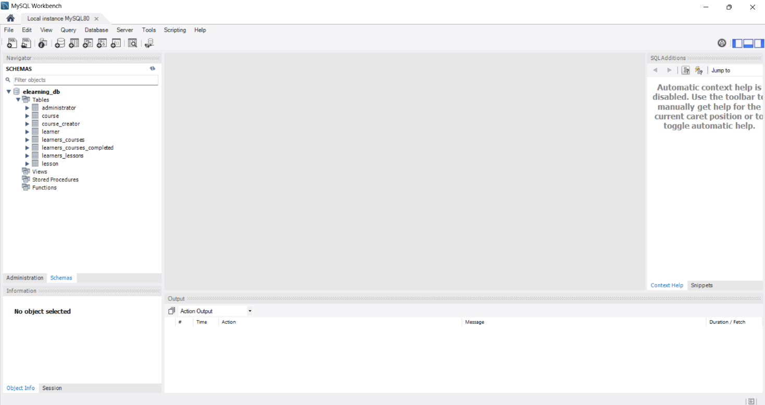
MySQL

Slide 42
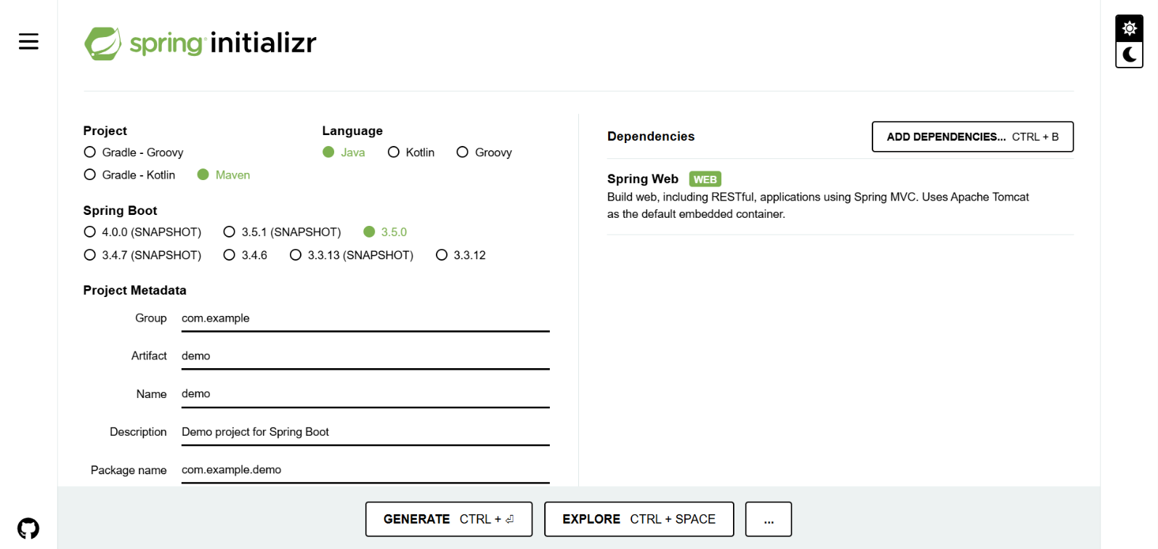
Spring

Slide 43
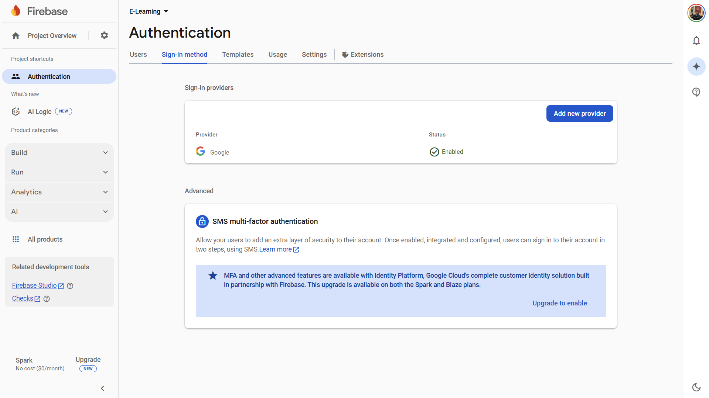
Google OAuth 2.0

Slide 44
Agenda
Short overview
Use-cases walkthrough
Technologies walkthrough
Size

Slide 45
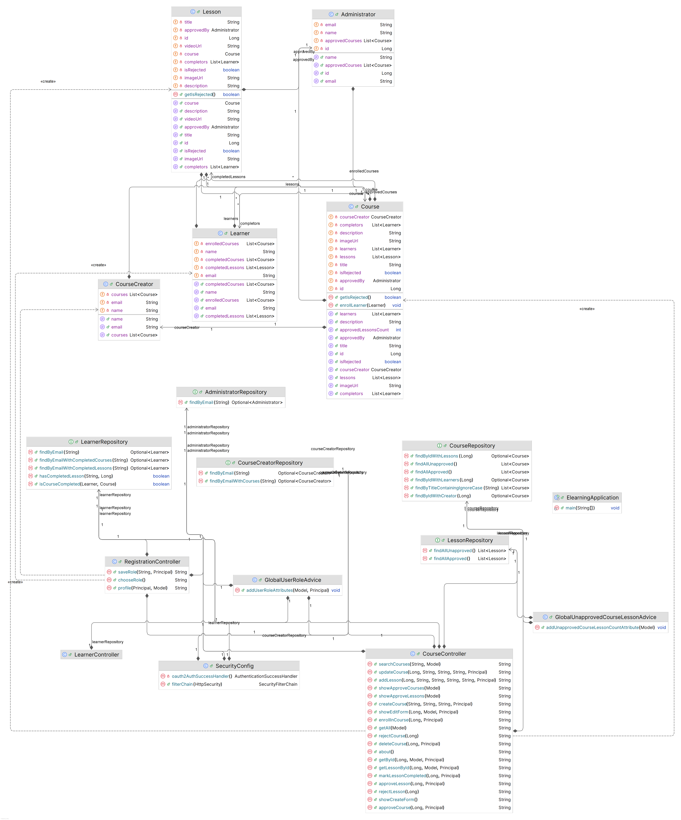
Class diagram

Slide 46
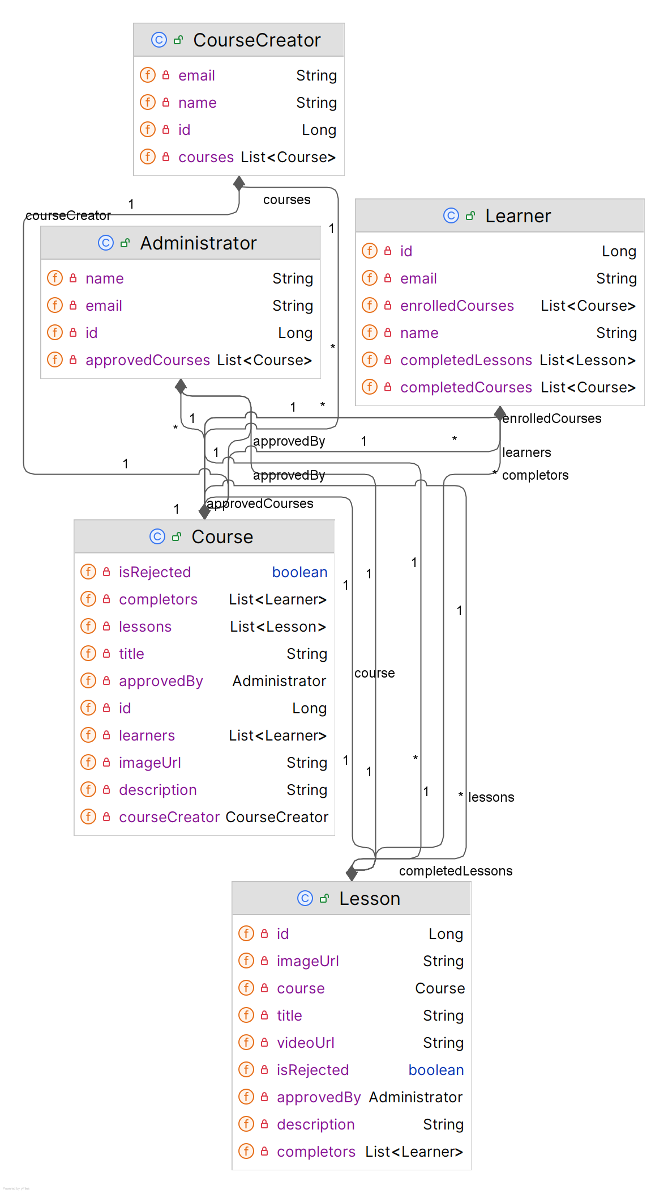
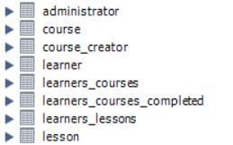
Database entities diagram

Slide 47
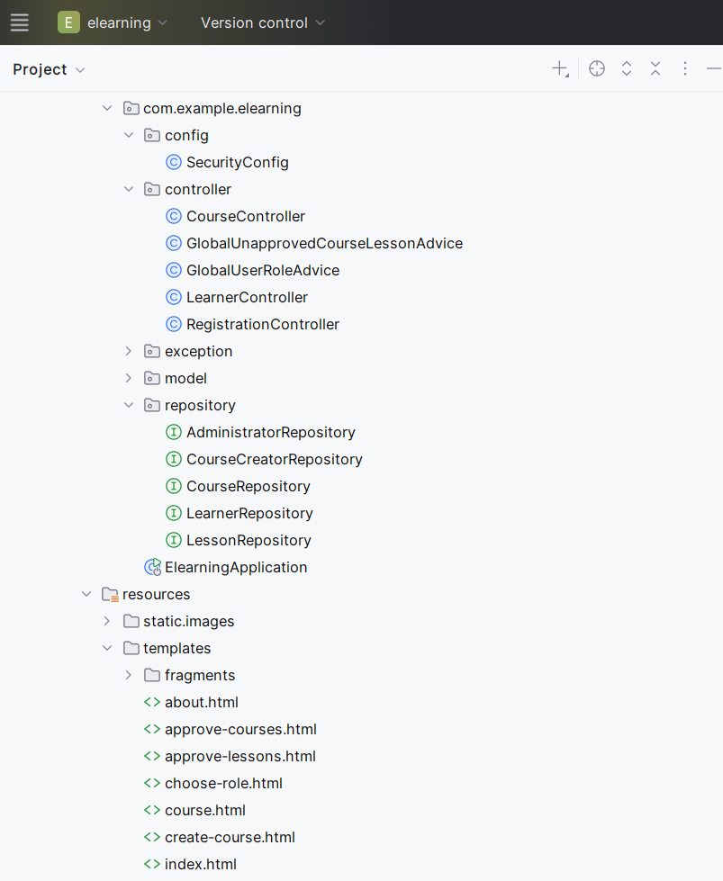
Code metrics
Lines of code:
Java: 929
HTML: 804
Comment: 117

Slide 48
Thank you
E-Learning Platform
Created by: Marsel Yuldashev
Supervised by: AL-Magsoosi Husam Kareem Farhan

